Slide 1
SAT & ACT Analysis

Slide 2
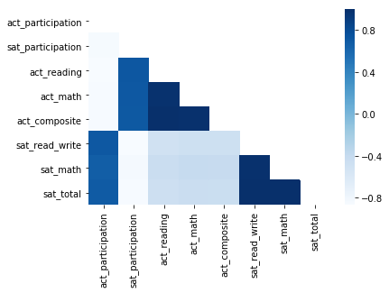
Overview of the Available data
The Participation rates and Test scores are negatively correlated at state aggregate levels.
The presentation will focus on improving the SAT participation rates.
Actionable insights on improving the Test scores will require further granular analysis.

Slide 3
Tailor on ground action based on the SAT state level participation rates
ACT States
Focus on engaging the state level policy and decision makers:
Correct the misconception that SAT is a narrow test for advanced kids.
Focus on states with high participation for PSAT/ NMSQT.
Structure deals and contracts to shift to SAT (e.g Colorado and Illinois)
If shift to SAT is not possible then lobby to shift away from a mandated ACT only framework by focusing on the Straightforward and approach nature of the new SAT framework.
ACT States: SAT participation of less than 20%

Slide 4
Tailor on ground action based on the SAT state level participation rates
Growing States
Improve institutional engagement efforts with school systems in these states to encourage them to switch to the SAT framework by highlighting
The alignment of the test with the state and school curriculums
The emphasis on core skills.
Help the University admission officers to use reliable and valid results to do their job well.
Enable schools to administer tests during school hours.
Key States
Focus on deepening the existing institutional relationships.
Emphasize availability of Practice tests and online free tutoring (Khan Academy*) to enhance test scores.
Carry out further research on means to improve Test score.
Key States: More than 90% SAT participation rates.
Growing States: SAT Participation of 20-90%
Source: Washington Post

Slide 5
SAT Vs ACT Participation Rates over 2 years
Key States: More than 90% SAT participation rates. Growing States: SAT Participation of 20-90% ACT States: SAT participation of less than 20%

Slide 6
SAT Vs ACT Participation Rates over 2 years
Key States: More than 90% SAT participation rates. Growing States: SAT Participation of 20-90% ACT States: SAT participation of less than 20%

Slide 7
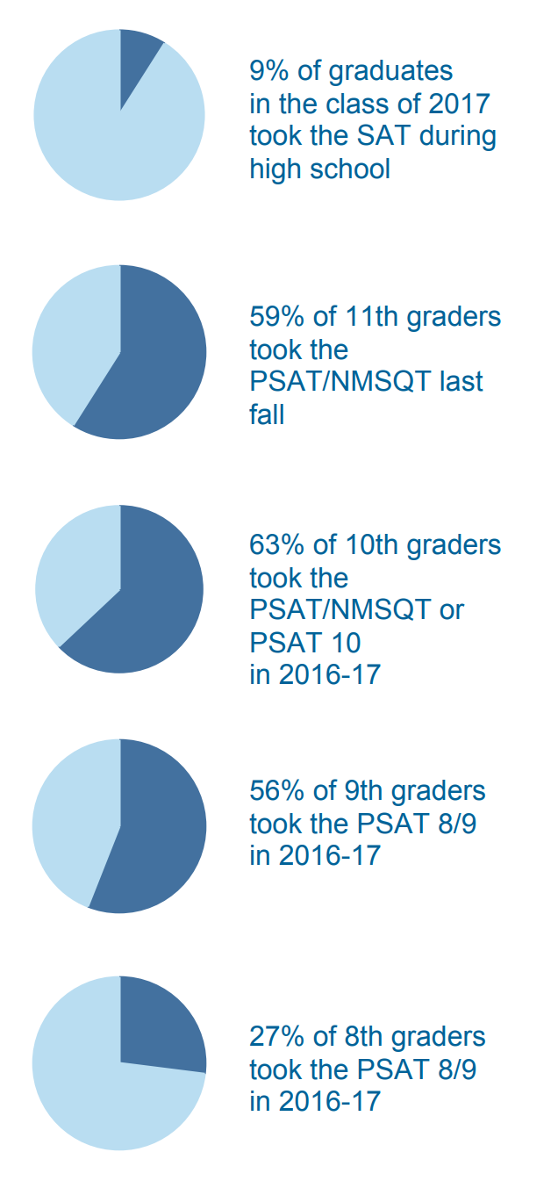
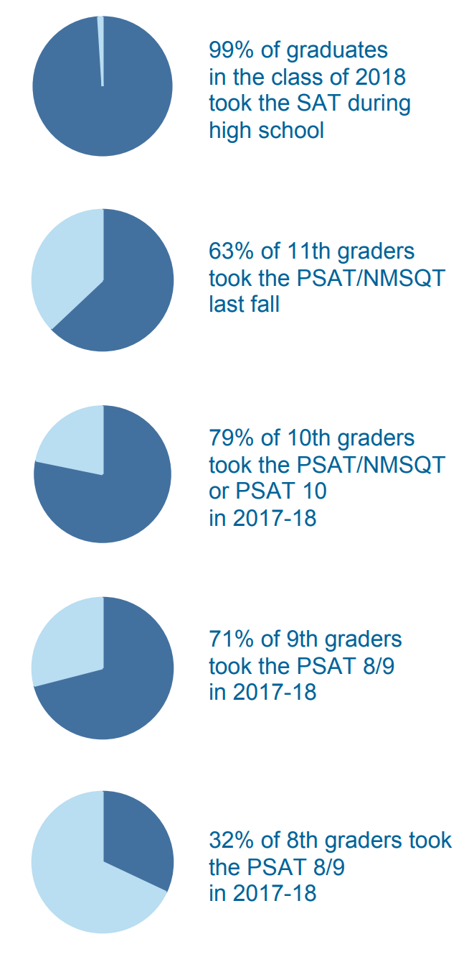
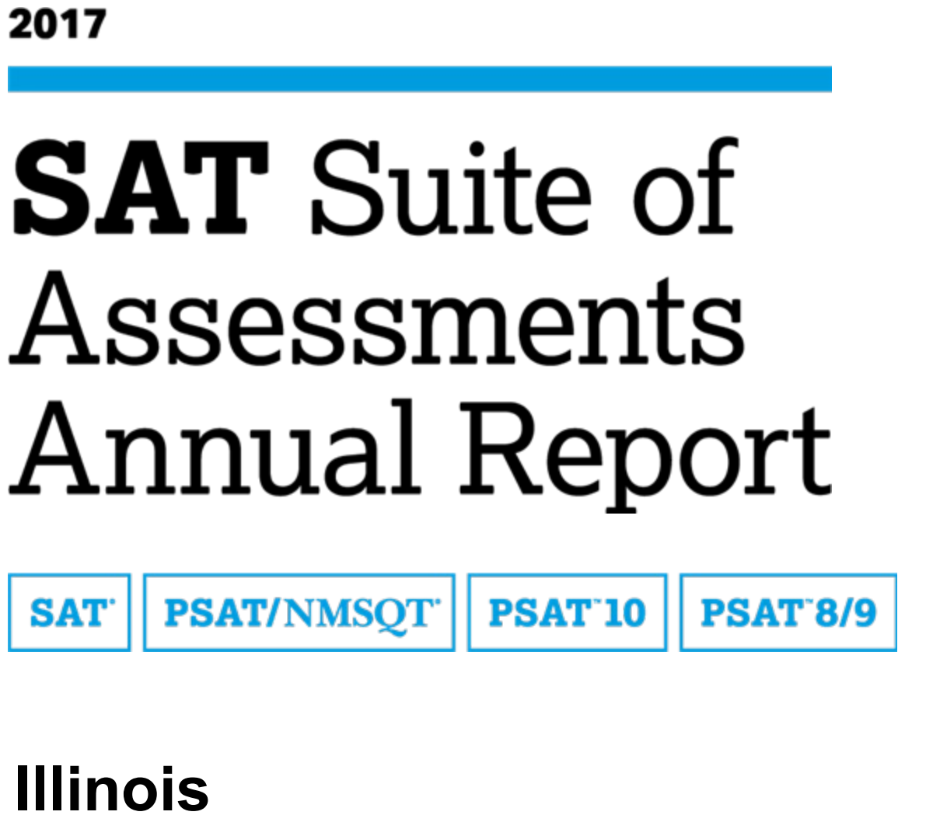
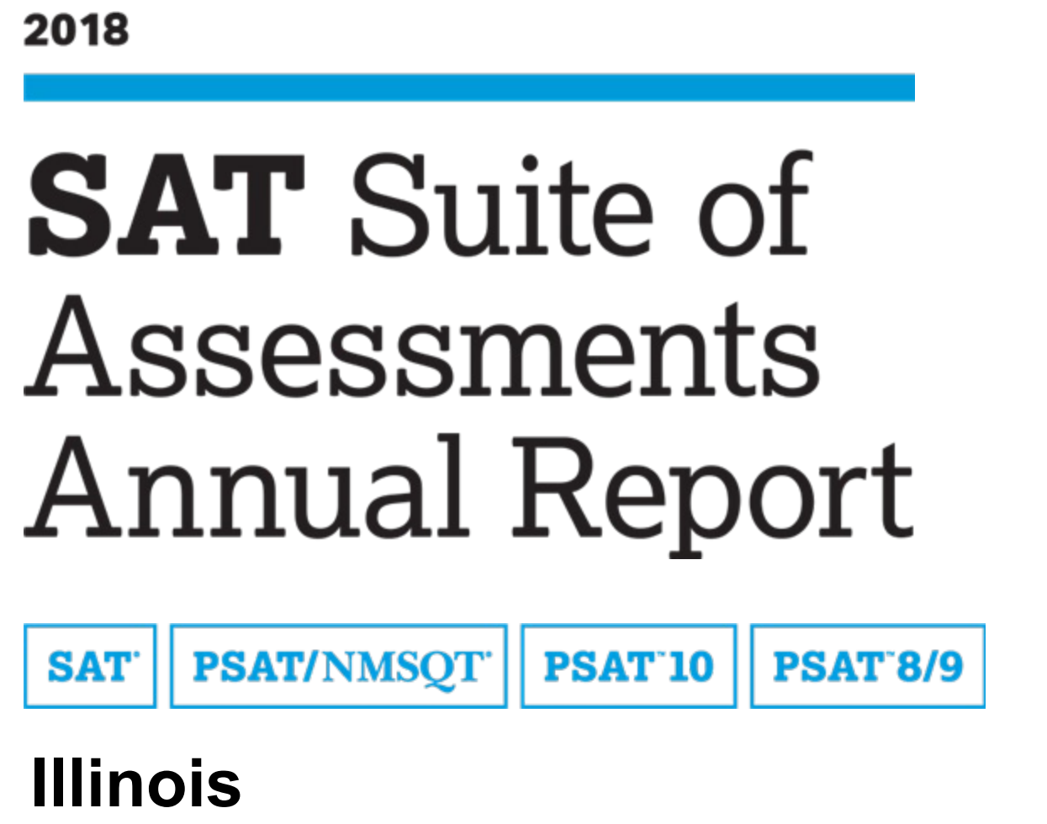
Case Study: Illinois
Proportion of High schoolers taking (PSAT/NMSQT, PSAT10, or PSAT8/9)
Key Points:
High PSAT/ NMSQT test taking could influence policy makers to switch to the SAT framework
Source:
2016-17
2017-18

Slide 8
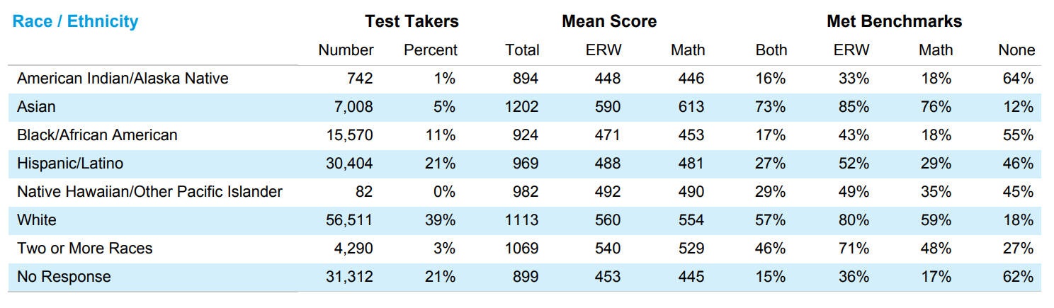
Case Study: Illinois
Key Points:
More research needed to analyse the test score outcomes. But the availability of granular data could help prioritize state level intervention programs.
Source:

